Slide 1

Determination of Equilibrium Income
Macroeconomics

Slide 2
Introduction to Income Determination
GDP (Y) = Consumption (C) + Investment (I) + Government Expenditure (G) + Net export (X-M)
Y (Income) = C + S + T + (X-M)
Y (Income) = C + I + G + (X-M)
Assuming a closed economy, Identity for Investment and Saving,
C + I + G = GDP = Y = C + S + T
So the National Income C + I + G = Y = C + S + T ………………….(2)
The above equation is in Nominal terms.
We convert it into real terms (divided by price level).
Real Output Identity, . c + i + g = y = c + s + t ………………..(3)

Slide 3
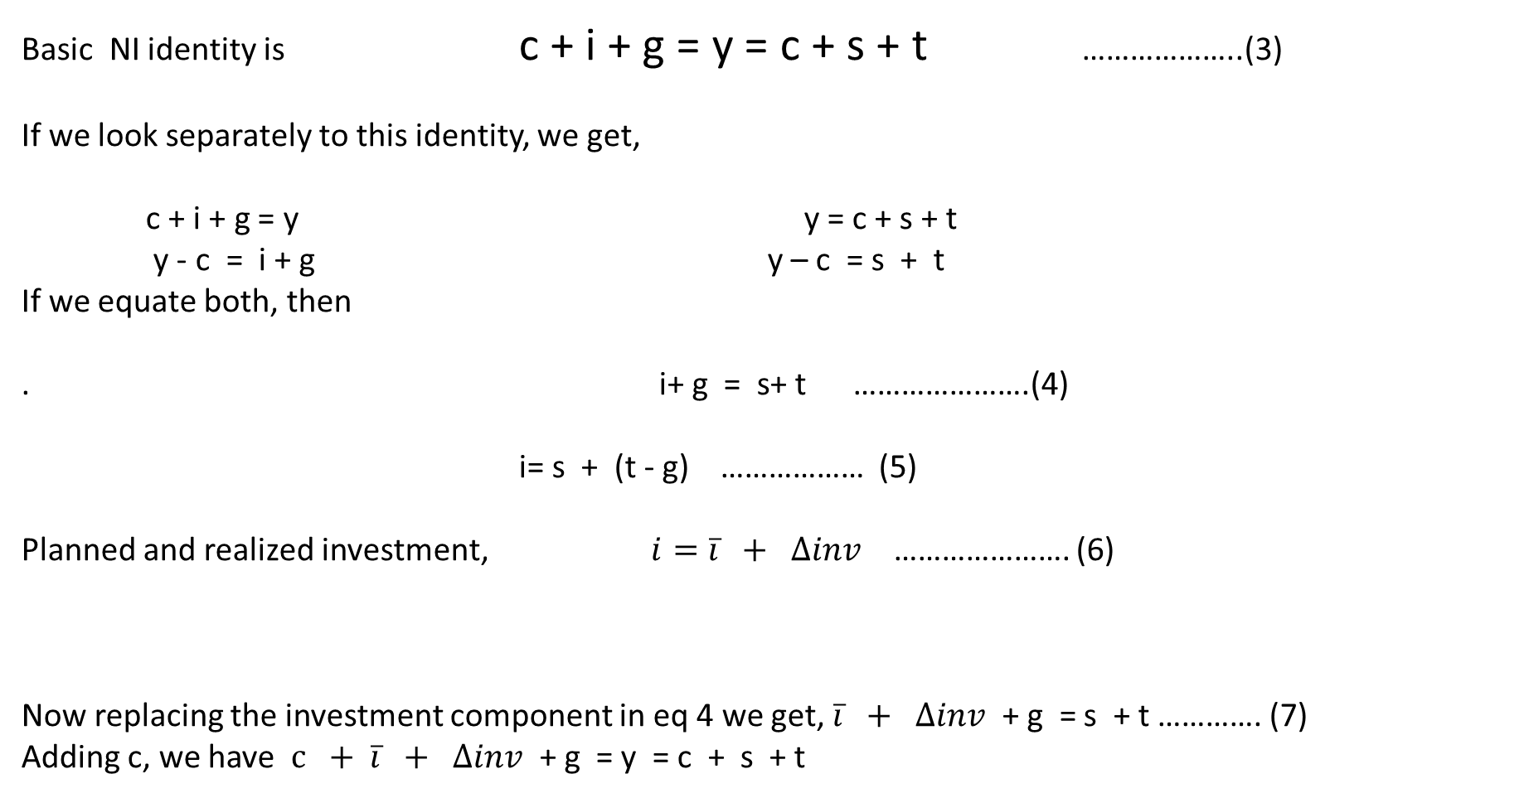
Saving- Investment Balance
Basic NI identity is c + i + g = y = c + s + t ………………..(3)
If we look separately to this identity, we get,
c + i + g = y y = c + s + t
y - c = i + g y – c = s + t
If we equate both, then
. i+ g = s+ t ………………….(4)
i= s + (t - g) ……………… (5)
Planned and realized investment, $i=\overline{i} + ∆inv$ …………………. (6)
Now replacing the investment component in eq 4 we get, $\overline{i} + ∆inv$ + g = s + t …………. (7)
Adding c, we have $c + \overline{i} + ∆inv$ + g = y = c + s + t
Unforeseen Changes in Inventory
Planned
Investment
Unplanned Investment

Slide 4
Tax, Consumption and Saving functions
Tax revenue is a function of income y,
t = t(y) : t’ > 0 : t’ = dt/dy change in tax with the change in income is positive.
Both consumption(c) and savings (s) are the functions of disposable income i.e. income after tax,
Disposable income (DI) = y - t(y)
C = c(y -t(y))
S = s(y-t(y))
c’ > 0, This is also known as MPC.
s’ > 0, This is also known as MPS.
MPC + MPS = 1.

Slide 5
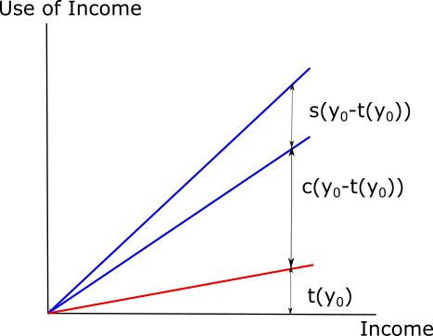
Tax, Consumption and Saving functions
This is a 45̊̊ line.
This diagram shows how we use the income.
Area below the 45 degree line is total income.
Below red line we pay tax. Rest is DI.
Area which shows c(y-t(y)) is consumption.
Rest is saved.

Slide 6

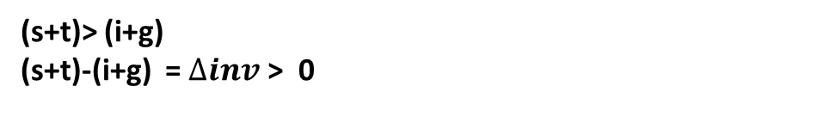
Determination of Equilibrium Income
$\overline{i} + ∆inv$ + g = s + t $\overline{i} + ∆inv$ + g = s (y- t(y)) + t (y)
, $\overline{i}$+ g = s (y- t(y)) + t (y) ………. (12) : This is the equilibrium condition.
0 for equilibrium
This is the inventory or unexpected part
0 for equilibrium
Planned Investment plus government expenditure
Savings plus tax revenue
If income increases then,
(s+t)> (i+g)
(s+t)-(i+g) = $∆inv$ > 0
$∆inv$>0, means there will be extra inventory. So producers will call back the orders until $∆inv$ = 0.
Similarly if $∆inv$<0 then there will be unexpected demand and to meet that producers will expand and then $∆inv$= 0 equilibrium reached.

Slide 7
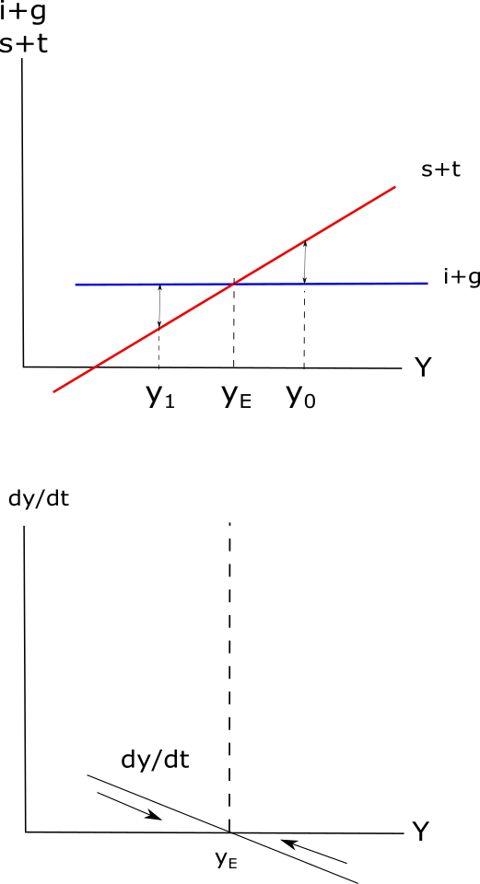


Determination of Equilibrium Income
Stability of the Equilibrium Income
Equilibrium Income
At y₀, (s+t)>(i+g), producers will cut back production.
At y₁, (s+t)<(i+g). Demand is high, producers start producing more.
(s+t) is +vely sloped, because both are function of y. Now i and g both are autonomous, so (i+g) is fixed independently. It is a horizontal line.
Where (s+t) =(i+g) there is equilibrium income.
y_{E} = Equilibrium income
y₀ = New income if (s+t)>(i+g)
y₁ =(s+t)<(i+g)
$∆inv$
$∆inv$
dy/dt is positive so income y will be rising to point y_{E.}
Similarly dy/dt is –ve it will go back to y_{E.}

Slide 8

Equilibrium Income and Deviation: An example
Let
$$C=20+\frac{3}{4}Y$$
$$I=20$$
$$Equlibrium Y=C+I$$
$$Y=20+\frac{3}{4}Y+20$$
$$Y−\frac{3}{4}Y=40$$
$$\frac{1}{4}Y=40$$
$$Y=160$$
$$or$$
$$Equalibrium income is reached when S=I$$
$$−20+\frac{1}{4}Y=20$$
$$Y=160$$
Actual income may be greater than or less than the equilibrium income.
Equilibrium income can be arrived at by the increase or decrease in inventories until change in inventories become zero.

Slide 9
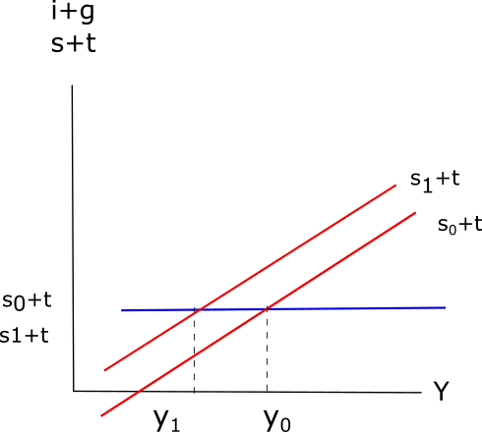
Determination of Equilibrium Income
Shifts in the saving function
Saving increased from s₀ to s₁
Income decreased from y₀ to y₁

Slide 10
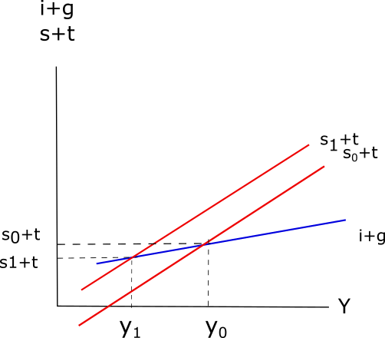
Determination of Equilibrium Income
Shifts in the saving function
_{IF} (i+g) is a function of y then (i+g) will be a positively sloped line.
Change in y will be much higher than the normal case
Paradox of Thrift

Slide 11
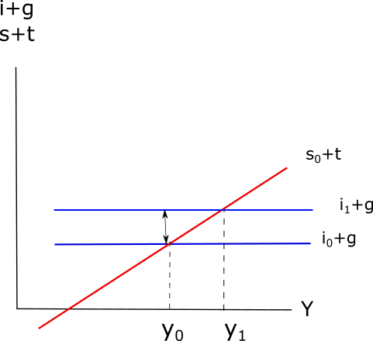
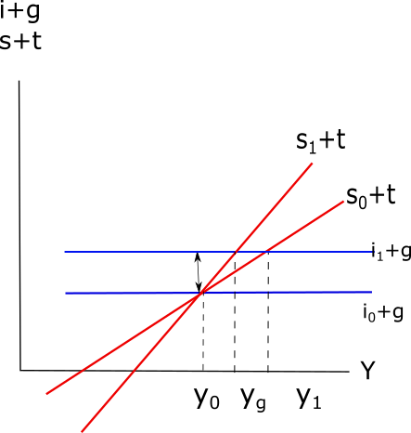


Determination of Equilibrium Income
Increase in The Investment
$∆inv$
$∆inv$

Slide 12
References
William H Branson, Macroeconomic Theory and Policy, Second Edition, Unversal Book Stall, New Delhi
E Shapiro, Macroeconomic Analysis, 5th Edition, Galgotia Publication Pvt Ltd., New Delhi.

